Slide 1
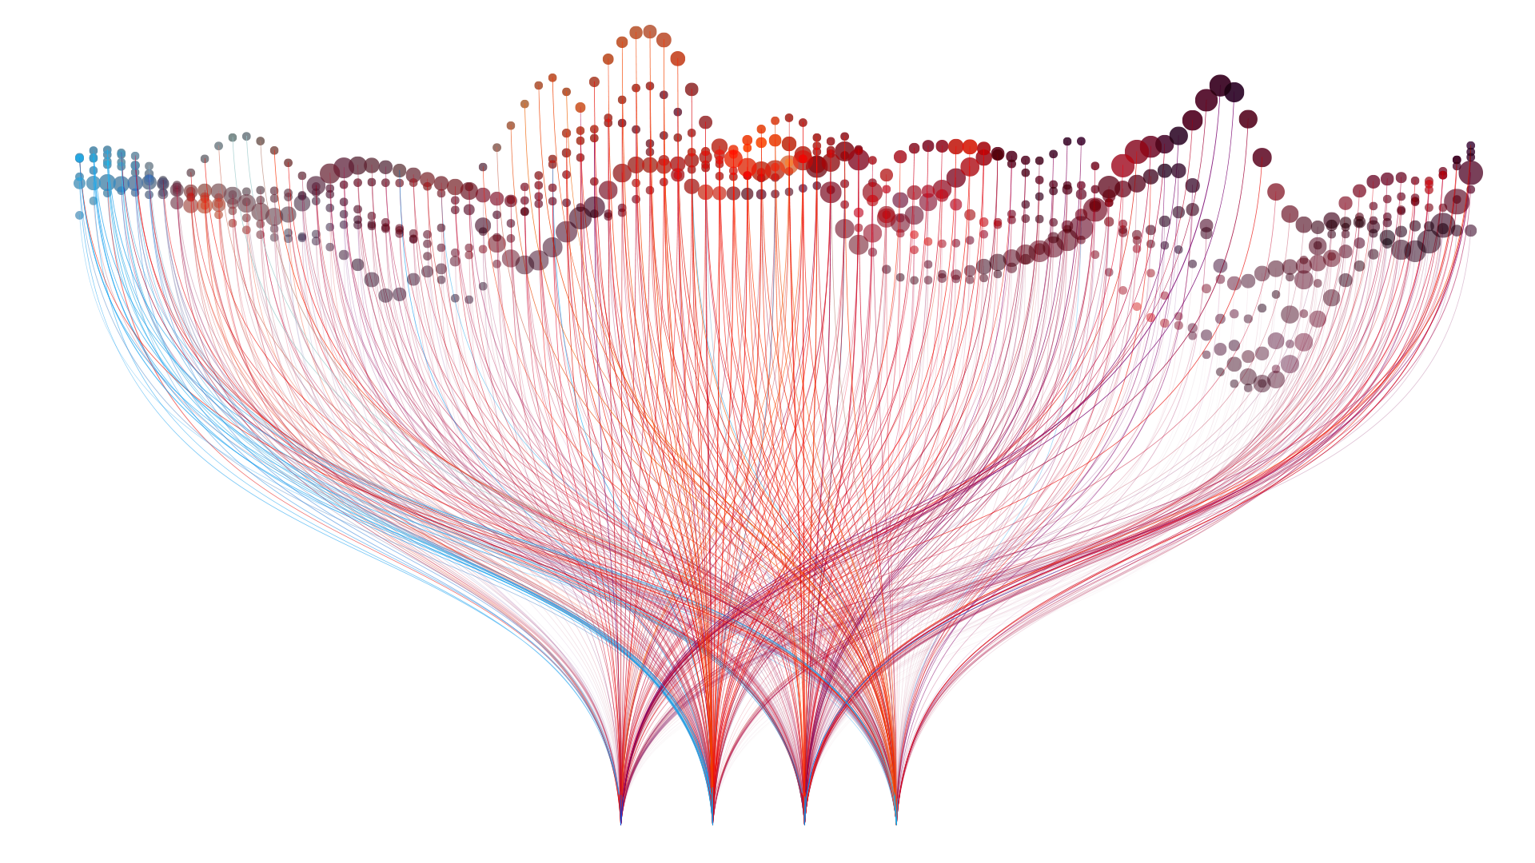
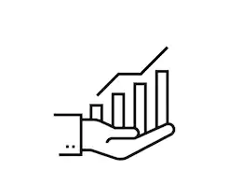
Data Visualization
Storytelling
Tezca Hernández
Raúl Domínguez
Alejandra Guizar
Edward González
Martha Meses

Slide 2

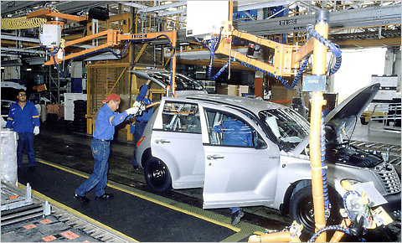
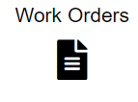

Project explanation
Objective: research automobile plants, their processes, business units, most effective plants and propose improvements.
We intended to analyze the following:
Work orders status
Plants effectiveness
Quality assurance
General business overview
findings per plant per month / year.
total work orders, checklist per plant, business unit and plant.
employees performance, rotation of personnel, users discharged and users with no activity.

Slide 3
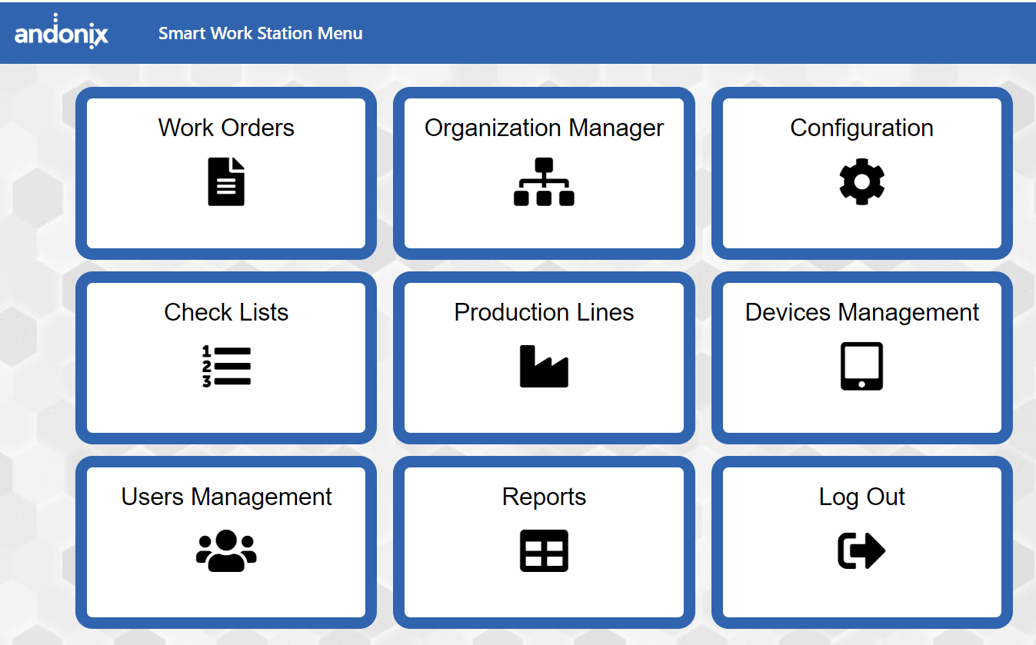
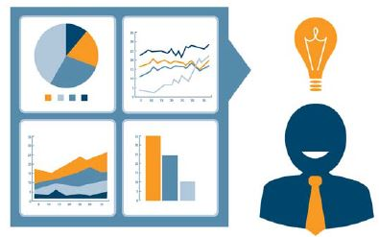

Server process
Understand complexities of working with automobile information and the databases.
Using an online app that records in real time and records quality records.
Benefits: real time data -
Selected databases and the information we wanted for the analysis, started graph.
Technical level connection.
Why MongoDB
Faster and less expensive to develop
Quick to learn, scalable easily
Simple / Flexible / Versatility / Dynamic

Slide 4
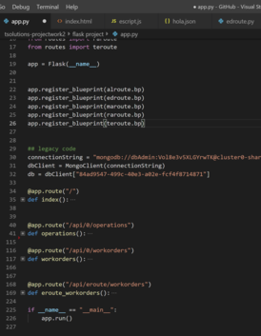
Technical explanation
Technical connection
How can we work all together with the same code, in different locations?
How can we get real time data without hurting the server performance?
How to create a real time dynamic ETL?
Issues encountered:
Accesibility
Understanding the business
Connecting / doing relationships
Understanding Mongo aggregation framework

Slide 5
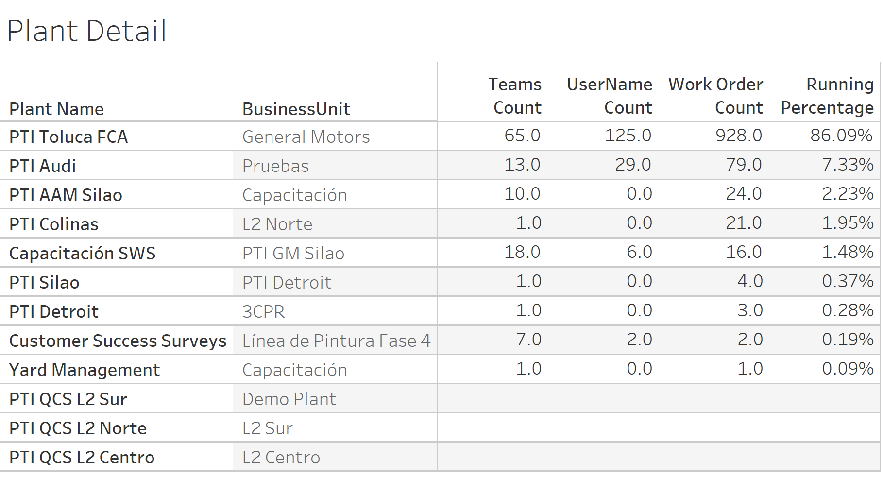
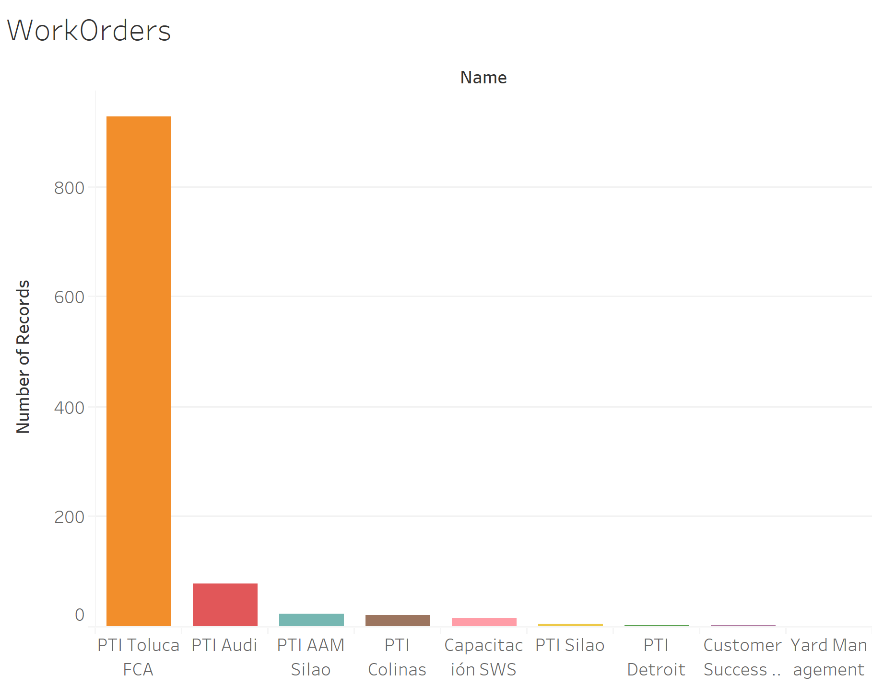
Plant details

Slide 6
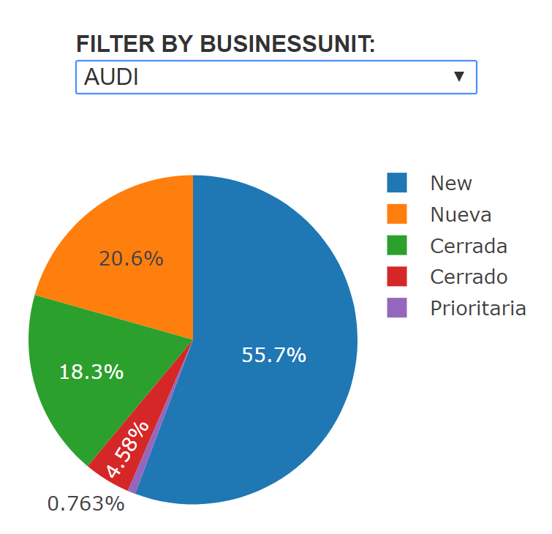
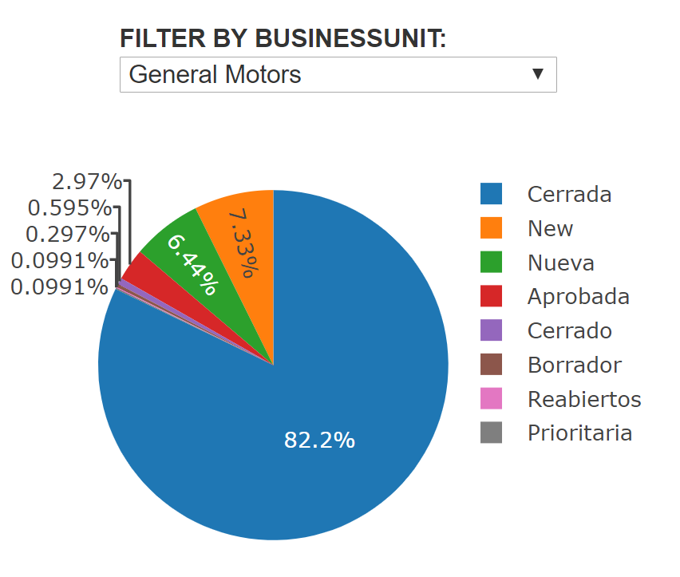
Work orders status
Identify the status of work orders (new, approved, closed, updated, suspended, priority) filtered by Business Units so we can find indicators of
Efficiency
Effectiveness
Workload (new work orders + priority work orders)
for each Plant.

